Slide 1
Unit 6 Linear Classification & Logistic Regression
EL-GY 6143/CS-GY 6923: Introduction to machine learning
Prof. Pei Liu

Slide 2
Learning Objectives
Formulate a machine learning problem as a classification problem
Identify features, class variable, training data
Visualize classification data using a scatter plot.
Describe a linear classifier as an equation and on a plot.
Determine visually if data is perfect linearly separable.
Formulate a classification problem using logistic regression
Binary and multi-class
Describe the logistic and soft-max function
Logistic function to approximate the probability
Derive the loss function for ML estimation of the weights in logistic regression
Use sklearn packages to fit logistic regression models
Measure the accuracy of classification
Adjust threshold of classifiers for trading off types of classification errors. Draw a ROC curve.
Perform LASSO regularization for feature selection

Slide 3
Outline
Motivating Example: Classifying a breast cancer test
Linear classifiers
Logistic regression
Fitting logistic regression models
Measuring accuracy in classification

Slide 4
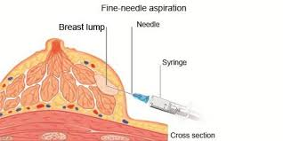
Diagnosing Breast Cancer
Fine needle aspiration of suspicious lumps
Cytopathologist visually inspects cells
Sample is stained and viewed under microscope
Determines if cells are benign or malignant
Also provides grading if malignant
Uses many features:
Size and shape of cells, degree of mitosis, differentiation, …
Diagnosis is not exact
If uncertain, use a more comprehensive biopsy
Additional cost and time
Stress to patient
Can machine learning provide better rules?
Grades of carcinoma cells
http://breast-cancer.ca/5a-types/

Slide 5
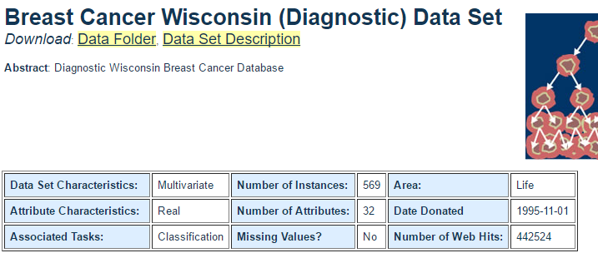
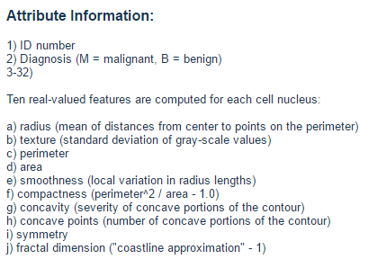
Data
Univ. Wisconsin study, 1994
569 samples
10 visual features for each sample
Ground truth determined by biopsy
First publication: O.L. Mangasarian, W.N. Street and W.H. Wolberg. Breast cancer diagnosis and prognosis via linear programming. Operations Research, 43(4), pages 570-577, July-August 1995.

Slide 6
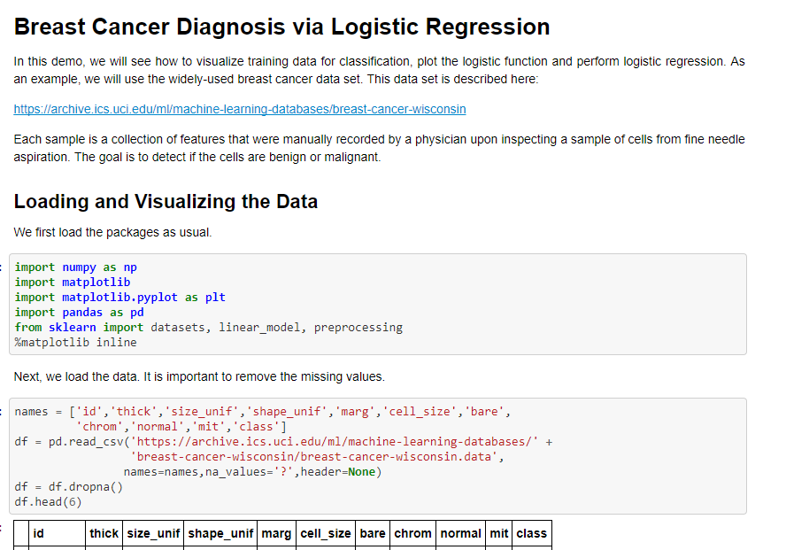
Demo on Github
Github: https://github.com/pliugithub/MachineLearning/tree/master/unit06_logistic/breast_cancer.ipynb

Slide 7
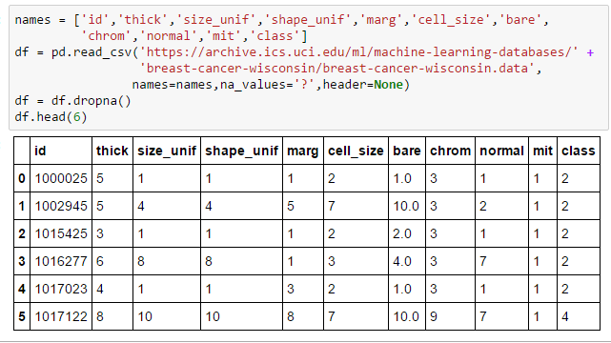
Loading The Data
Follow standard pandas routine
All code in Lect06_Demo.ipynb
Drops missing samples
Class = 2 => benign
Class = 4 => malignant
See following for explanation of attributes
https://archive.ics.uci.edu/ml/machine-learning-databases/breast-cancer-wisconsin/breast-cancer-wisconsin.names

Slide 8
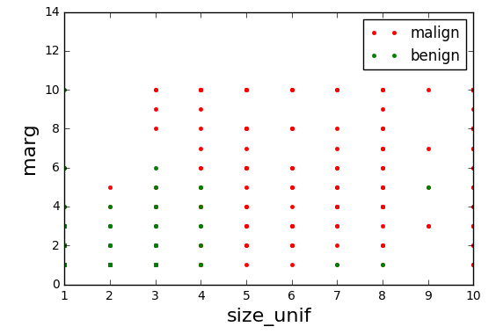
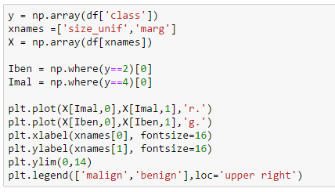
Visualizing the Data
Scatter plot of points from each class
Plot not informative
Many points overlap
Relative frequency at each point not visible

Slide 9
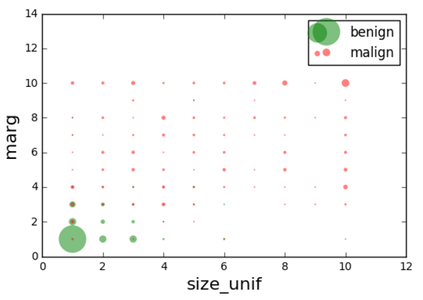
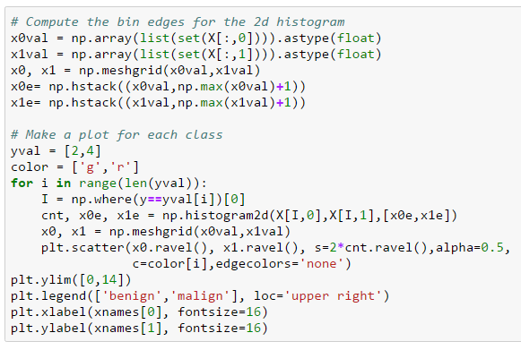
Improving the Plot
Make circle size proportional to count
Many gymnastics to make this plot in python

Slide 10
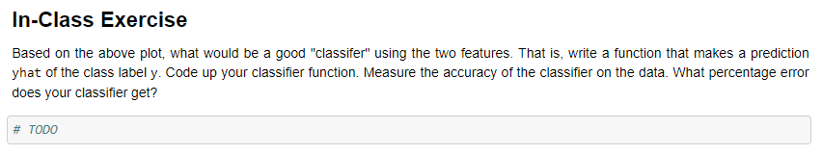
In-Class Exercise
Get into groups
At least one must have a laptop with jupyter notebook
Determine a classification rule
Predict class label from the two features
Test in python
Make the predictions
Measure the accuracy

Slide 11
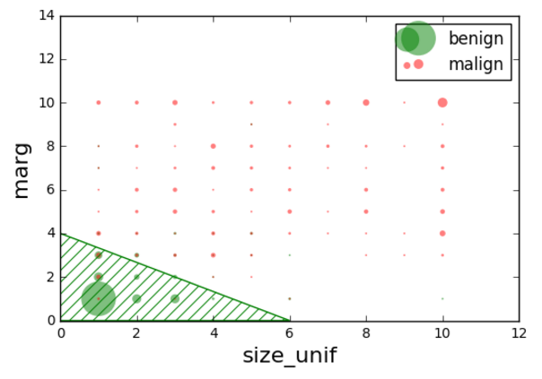
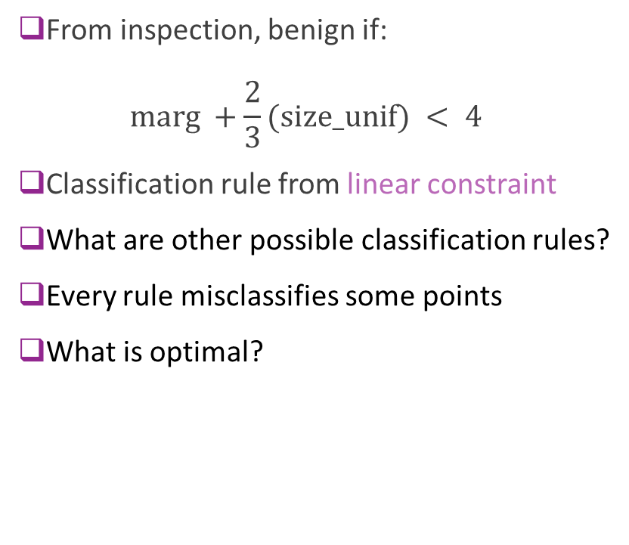
A Possible Classification Rule
From inspection, benign if: $\text{marg} +\frac{2}{3}(\text{size}\text{_}\text{unif}) < 4$
Classification rule from linear constraint
What are other possible classification rules?
Every rule misclassifies some points
What is optimal?

Slide 12
Mangasarian’s Original Paper
Proposes Multisurface method – Tree (MSM-T)
Decision tree based on linear rules in each step
Fig to left from
Pantel, “Breast Cancer Diagnosis and Prognosis,” 1995
Best methods today use neural networks
This lecture will look at linear classifiers
These are much simpler
Do not provide same level of accuracy
But, building block to more complex classifiers

Slide 13
Outline
Motivating Example: Classifying a breast cancer test
Linear classifiers
Logistic regression
Fitting logistic regression models
Measuring accuracy in classification

Slide 14
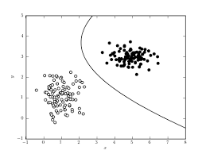
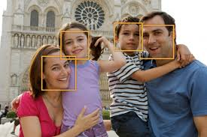
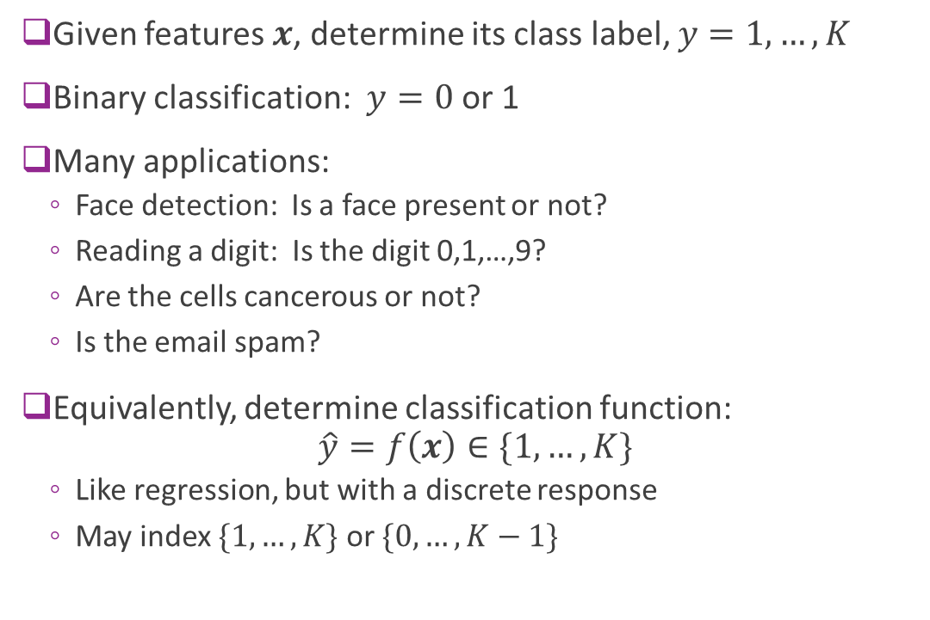
Classification
Given features $x$, determine its class label, $y=1,…,K$
Binary classification: $y=0$or 1
Many applications:
Face detection: Is a face present or not?
Reading a digit: Is the digit 0,1,…,9?
Are the cells cancerous or not?
Is the email spam?
Equivalently, determine classification function: $\hat{y}=f\left(x\right)∈\{1,…,K\}$
Like regression, but with a discrete response
May index $\{1,…,K\}$ or $\{0,…,K−1\}$

Slide 15
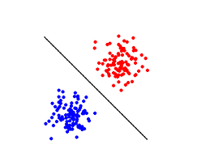
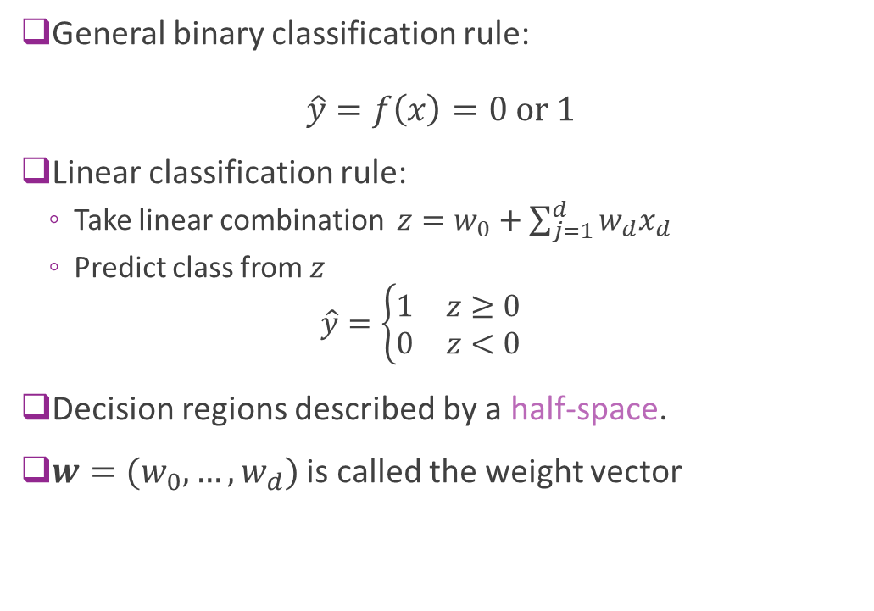
Linear Classifier
General binary classification rule: $\hat{y}=f\left(x\right)=0 \text{or} 1$
Linear classification rule:
Take linear combination $z=w_{0}+\sum_{j=1}^{d}{{w_{d}x}_{d}}$
Predict class from $z$ $\hat{y}=\left\{\begin{matrix}1 & z≥0 \\ 0 & z<0\end{matrix}\right.$
Decision regions described by a half-space.
$w=(w_{0},…,w_{d})$ is called the weight vector

Slide 16
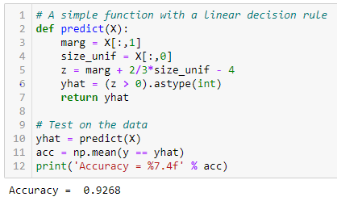
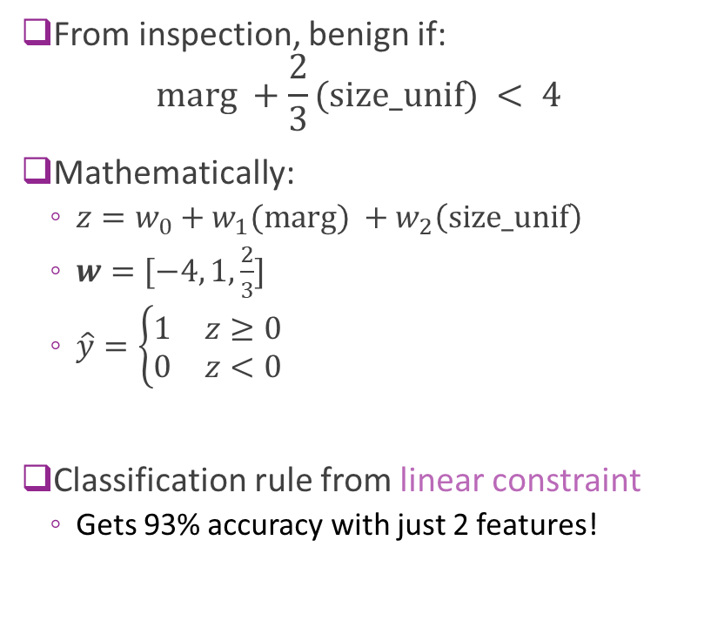
Breast Cancer Example
From inspection, benign if: $\text{marg} +\frac{2}{3}(\text{size}\text{_}\text{unif}) < 4$
Mathematically:
$z=w_{0}+w_{1}(\text{marg}\text{)} +w_{2}\left(\text{size}\text{_}\text{unif}\right)$
$w=[−4, 1,\frac{2}{3}]$
$\hat{y}=\left\{\begin{matrix}1 & z≥0 \\ 0 & z<0\end{matrix}\right.$
Classification rule from linear constraint
Gets 93% accuracy with just 2 features!

Slide 17
Breast Cancer Example
Questions for today:
How do we use all 10 features?
How do we fit an optimal linear classifier?
What is optimal?

Slide 18
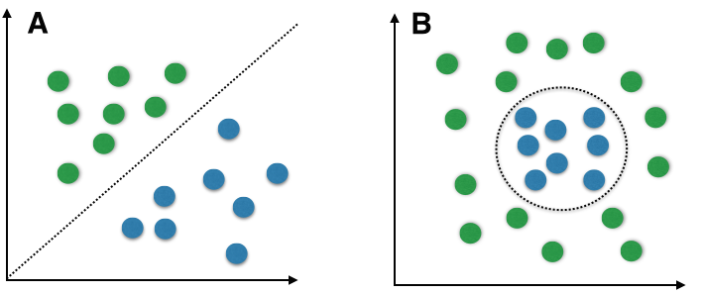
Linear vs. Non-Linear
Linear boundaries are limited
Can only describe very simple regions
But, serves as building block
Many classifiers use linear rules as first step
Neural networks, decision trees, …
Breast cancer example:
Is the region linear or non-linear?

Slide 19

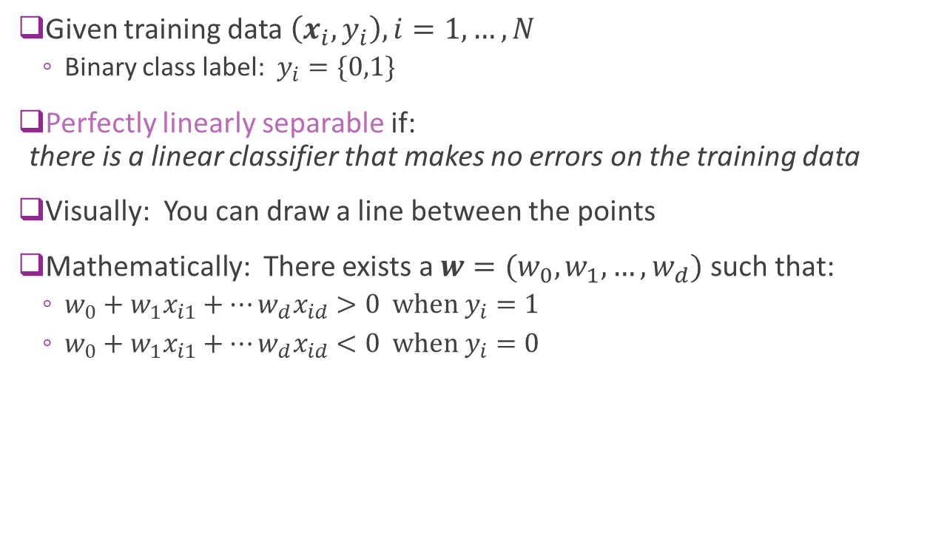
Perfect Linear Separability
Given training data $\left(x_{i},y_{i}\right), i=1,…,N$
Binary class label: $y_{i}=\{0,1\}$
Perfectly linearly separable if: there is a linear classifier that makes no errors on the training data
Visually: You can draw a line between the points
Mathematically: There exists a $w=(w_{0},w_{1},…,w_{d})$ such that:
$w_{0}+w_{1}x_{i1}+⋯w_{d}x_{id}>0 \text{when} y_{i}=1$
$w_{0}+w_{1}x_{i1}+⋯w_{d}x_{id}<0 \text{when} y_{i}=0$
$$w$$

Slide 20
Most Data not Perfectly Separable
Generally cannot find a separating hyperplane
Always, some points that will be mis-classified
Algorithms attempt to find “good” hyper-planes
Reduce the number of mis-classified points
Or, some similar metric

Slide 21
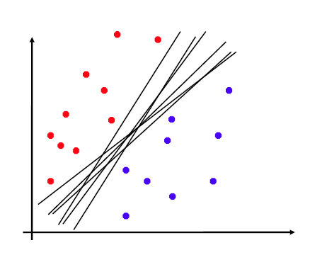
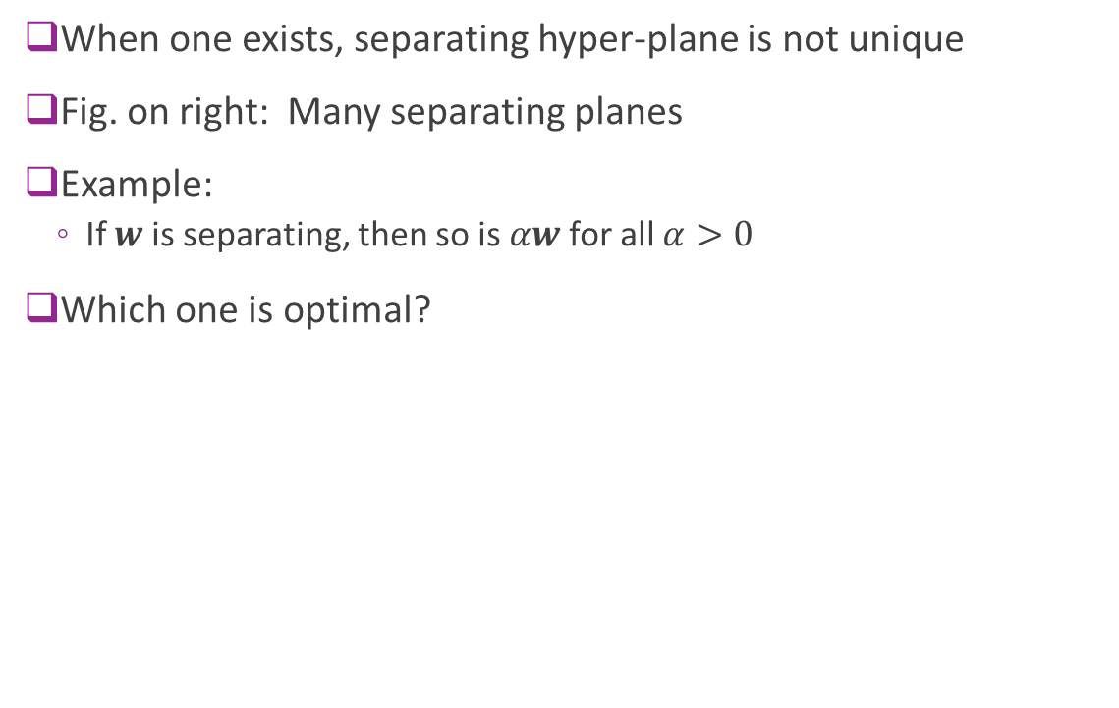
Non-Uniqueness
When one exists, separating hyper-plane is not unique
Fig. on right: Many separating planes
Example:
If $w$ is separating, then so is $αw$ for all $α>0$
Which one is optimal?

Slide 22
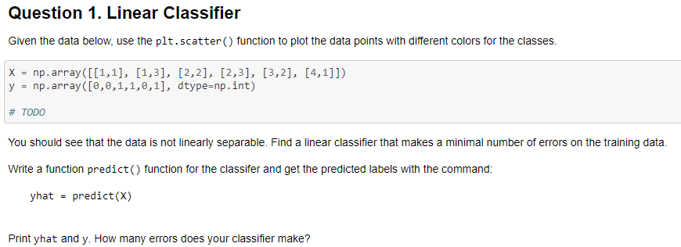
In-Class Exercise
Complete in logistic_inclass.ipynb
Can use Google colab or your local machine

Slide 23
Outline
Motivating Example: Classifying a breast cancer test
Linear classifiers
Logistic regression
Fitting logistic regression models
Measuring accuracy in classification

Slide 24

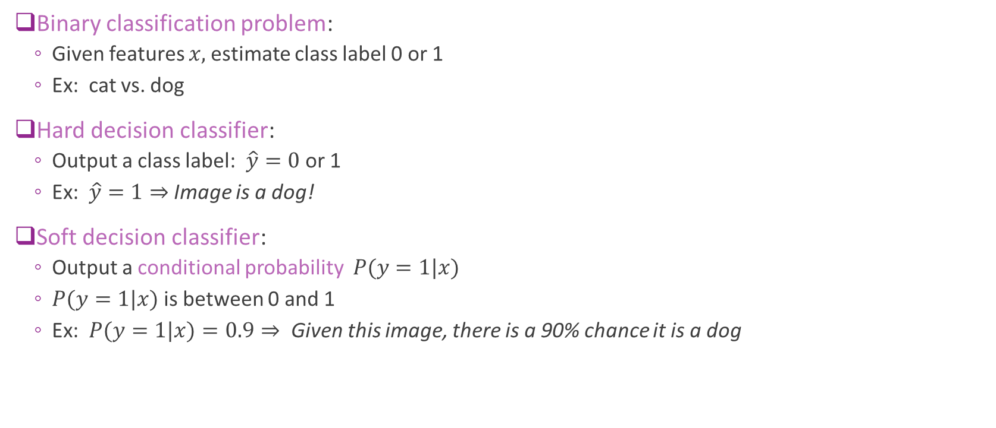
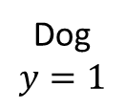
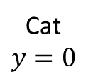
Hard vs. Soft Decision Classifiers
Binary classification problem:
Given features $x,$estimate class label 0 or 1
Ex: cat vs. dog
Hard decision classifier:
Output a class label: $\hat{y}=0$or 1
Ex: $\hat{y}=1⇒$ Image is a dog!
Soft decision classifier:
Output a conditional probability $P(y=1|x)$
$P(y=1|x)$is between 0 and 1
Ex: $P(y=1|x)=0.9⇒$Given this image, there is a 90% chance it is a dog
Cat
$$y=0$$
Dog
$$y=1$$

Slide 25

Why Use Soft Decision Classifiers?
In most problems, classifiers make errors
Example: Is the digit a 5 or 6?
Hard decision makes decision with certainty
But the decision can be wrong
Soft decision classifiers recognize this uncertainty
Easier to train soft decision classifier
Allows for error in training data
See next section
Provides a confidence measure
Example from MNIST dataset
True digit = 5
Hard decision
Digit = 6!
Soft decision
Digit = 5 with probability 30%
Digit = 6 with probability 70%

Slide 26
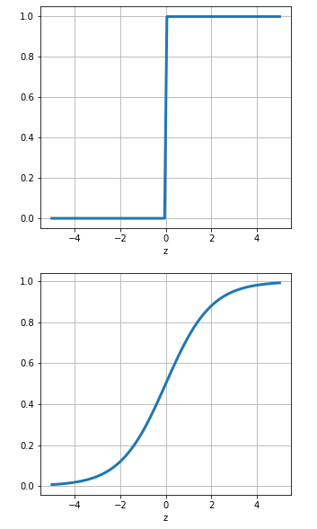
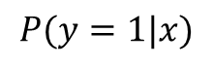
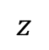
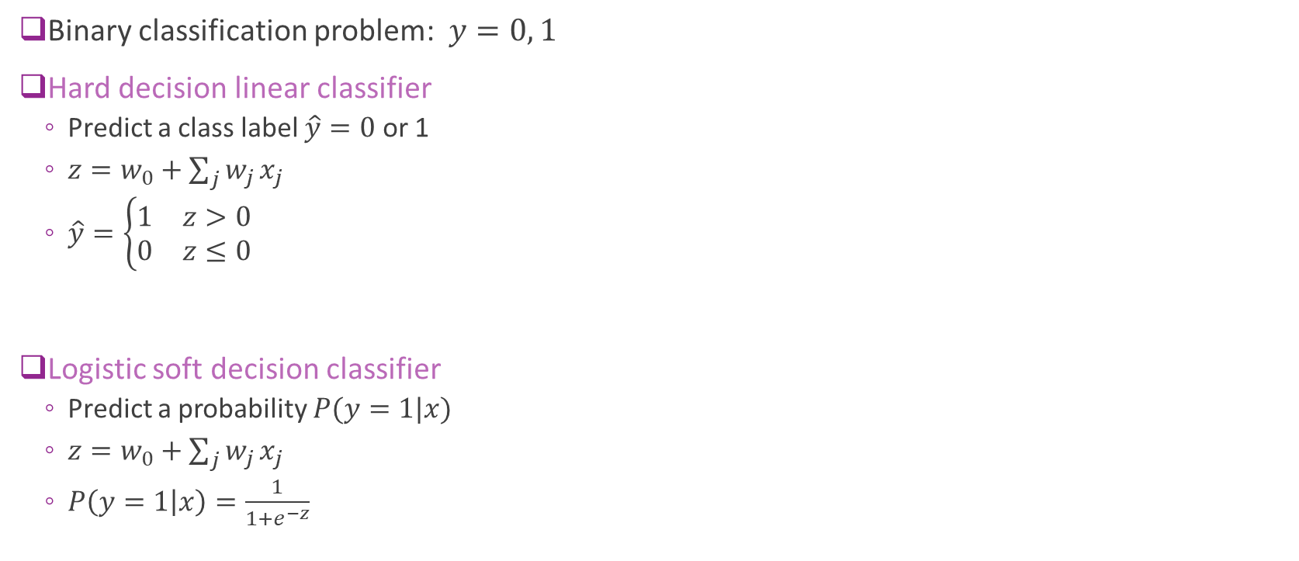
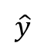
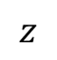
Logistic Model for Binary Classification
Binary classification problem: $y=0, 1$
Hard decision linear classifier
Predict a class label $\hat{y}=0$ or 1
$z=w_{0}+\sum_{j}{w_{j}}x_{j}$
$\hat{y}=\left\{\begin{matrix}1 & z>0 \\ 0 & z≤0\end{matrix}\right.$
Logistic soft decision classifier
Predict a probability $P(y=1|x)$
$z=w_{0}+\sum_{j}{w_{j}}x_{j}$
$P\left(y=1 | x\right)=\frac{1}{1+e^{−z}}$
$$\hat{y}$$
$$z$$
$$P(y=1|x)$$
$$z$$

Slide 27
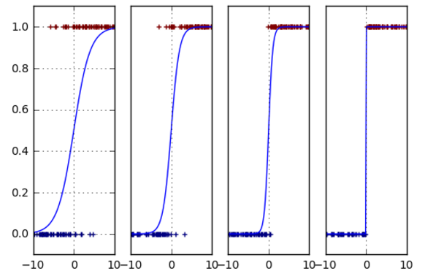
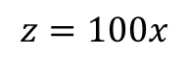
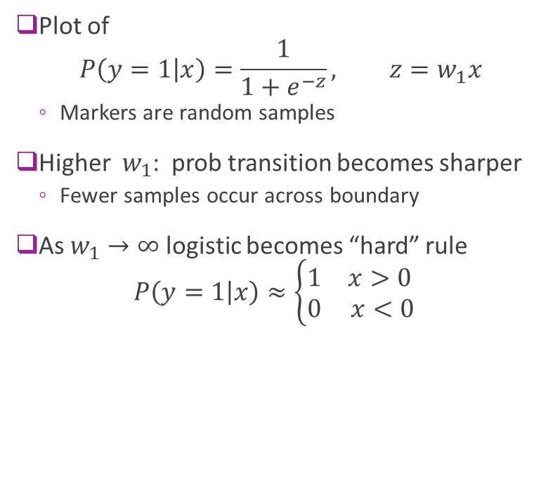
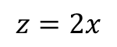
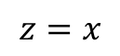
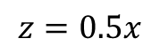
Logistic Model as a “Soft” Classifier
Plot of $P\left(y=1 | x\right)=\frac{1}{1+e^{−z}}, z=w_{1}x$
Markers are random samples
Higher $w_{1}$: prob transition becomes sharper
Fewer samples occur across boundary
As $w_{1}→∞$ logistic becomes “hard” rule $P\left(y=1 | x\right)≈\left\{\begin{matrix}1 & x>0 \\ 0 & x<0\end{matrix}\right.$
$$z=0.5x$$
$$z=x$$
$$z=2x$$
$$z=100x$$

Slide 28
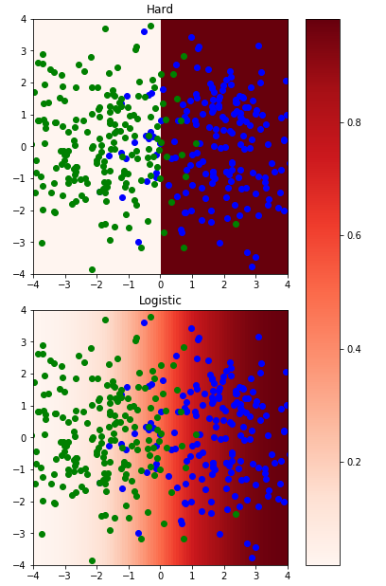
Hard vs. Soft Classification in 2D
Hard decision:
Divides space into two half-space
One for each class label
Soft decision
Gradual transition for probability 0 to 1

Slide 29
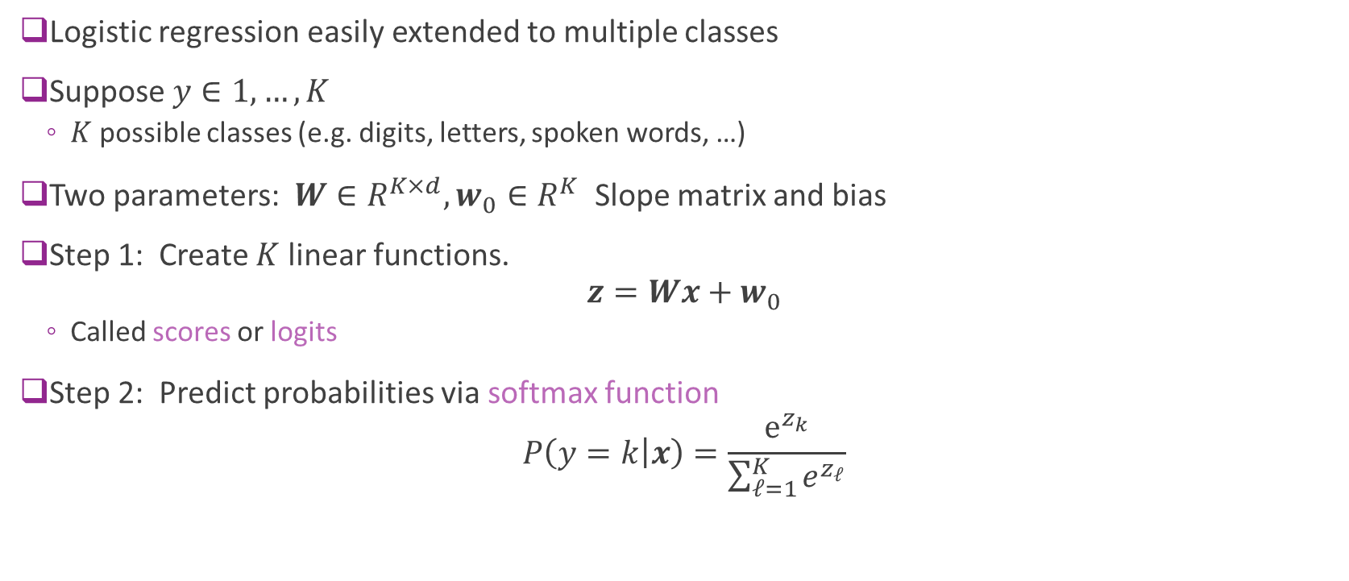
Multi-Class Logistic Regression
Logistic regression easily extended to multiple classes
Suppose $y∈1,…,K$
$K$ possible classes (e.g. digits, letters, spoken words, …)
Two parameters: $W∈R^{K×d}, w_{0}∈R^{K}$ Slope matrix and bias
Step 1: Create $K$ linear functions. $z=Wx+w_{0}$
Called scores or logits
Step 2: Predict probabilities via softmax function
$$P\left(y=k | x\right)=\frac{e^{z_{k}}}{\sum_{ℓ=1}^{K}{e^{z_{ℓ}}}}$$

Slide 30
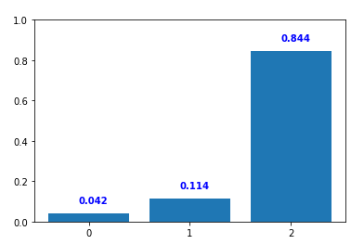
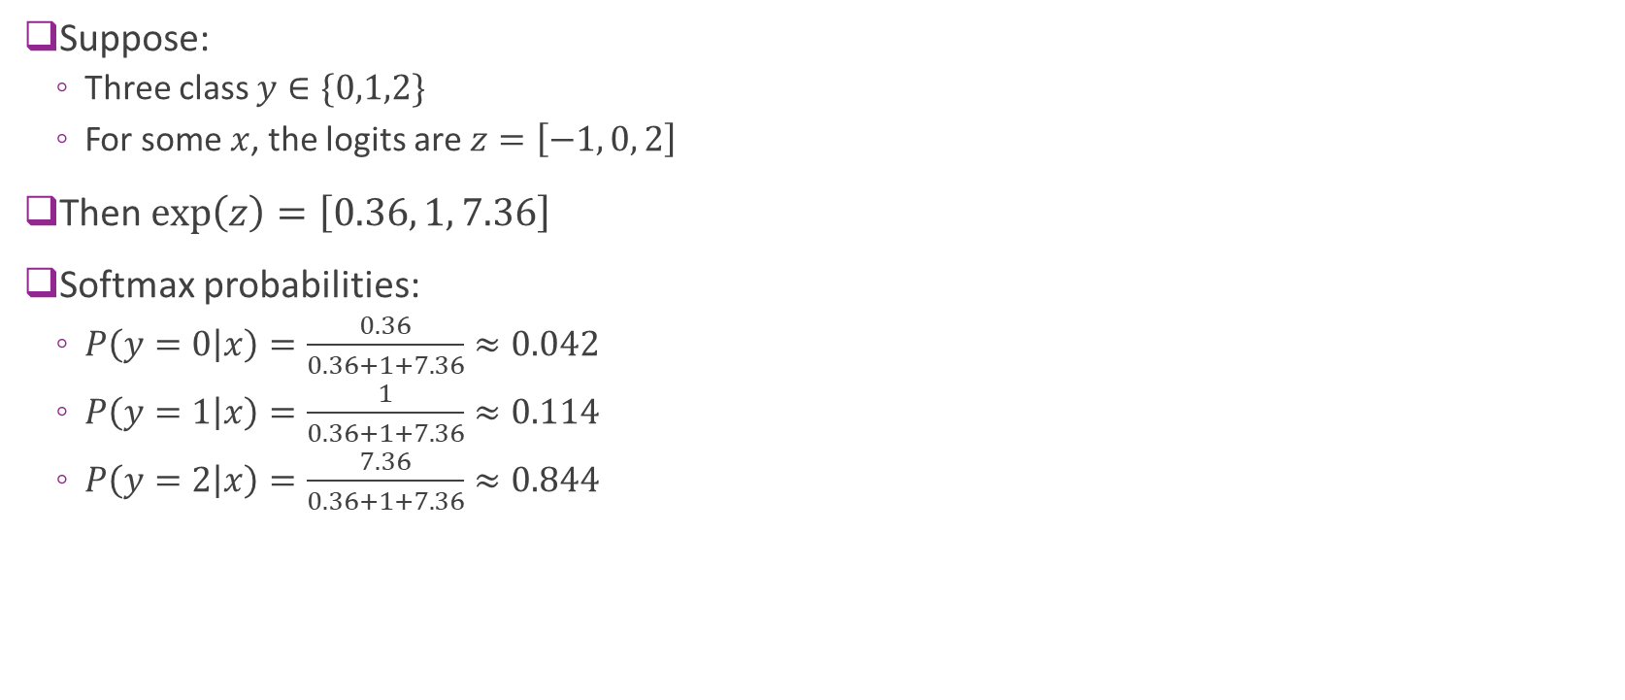
Softmax Example
Suppose:
Three class $y∈\{0,1,2\}$
For some $x$, the logits are $z=\left[−1, 0, 2\right]$
Then $\exp\left(z\right)=\left[0.36, 1, 7.36\right]$
Softmax probabilities:
$P\left(y=0 | x\right)=\frac{0.36}{0.36+1+7.36}≈0.042$
$P\left(y=1 | x\right)=\frac{1}{0.36+1+7.36}≈0.114$
$P\left(y=2 | x\right)=\frac{7.36}{0.36+1+7.36}≈0.844$
Probability
Class label

Slide 31
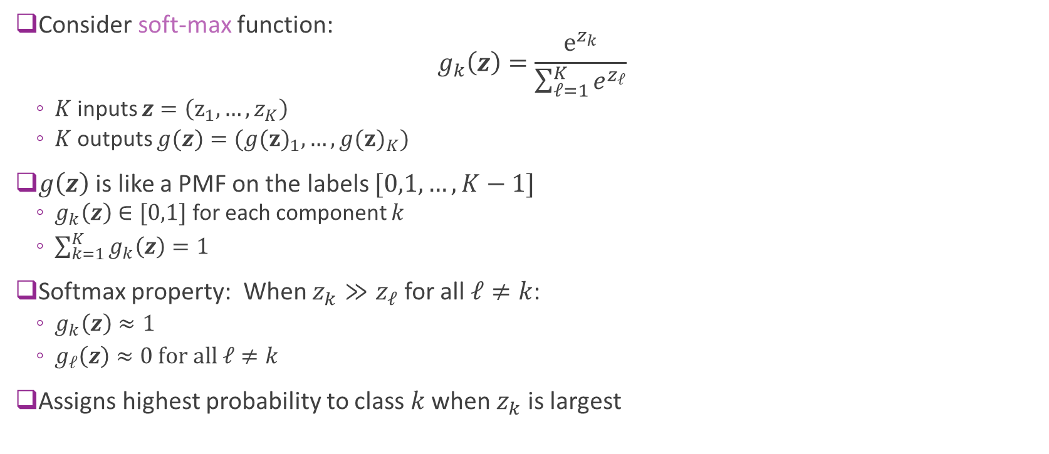
Softmax Properties
Consider soft-max function: $g_{k}\left(z\right)=\frac{e^{z_{k}}}{\sum_{ℓ=1}^{K}{e^{z_{ℓ}}}}$
$K$ inputs $z=\left(z_{1},…, z_{K}\right)$
$K$ outputs $g(z)=({g(z)}_{1},…, {g(z)}_{K})$
$g\left(z\right)$ is like a PMF on the labels $[0,1,…, K−1]$
$g_{k}\left(z\right)∈[0,1]$ for each component $k$
$\sum_{k=1}^{K}{g_{k}\left(z\right)}=1$
Softmax property: When $z_{k}≫z_{ℓ}$ for all $ℓ≠k$:
$g_{k}\left(z\right)≈1$
$g_{ℓ}\left(z\right)≈0 \text{for} \text{all} ℓ≠k$
Assigns highest probability to class $k$ when $z_{k}$ is largest
Probability
Class label

Slide 32
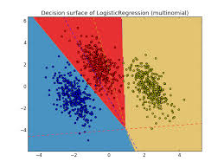
Multi-Class Logistic Regression Decision Regions
Each decision region defined by set of hyperplanes
Intersection of linear constraints
Sometimes called a polytope

Slide 33
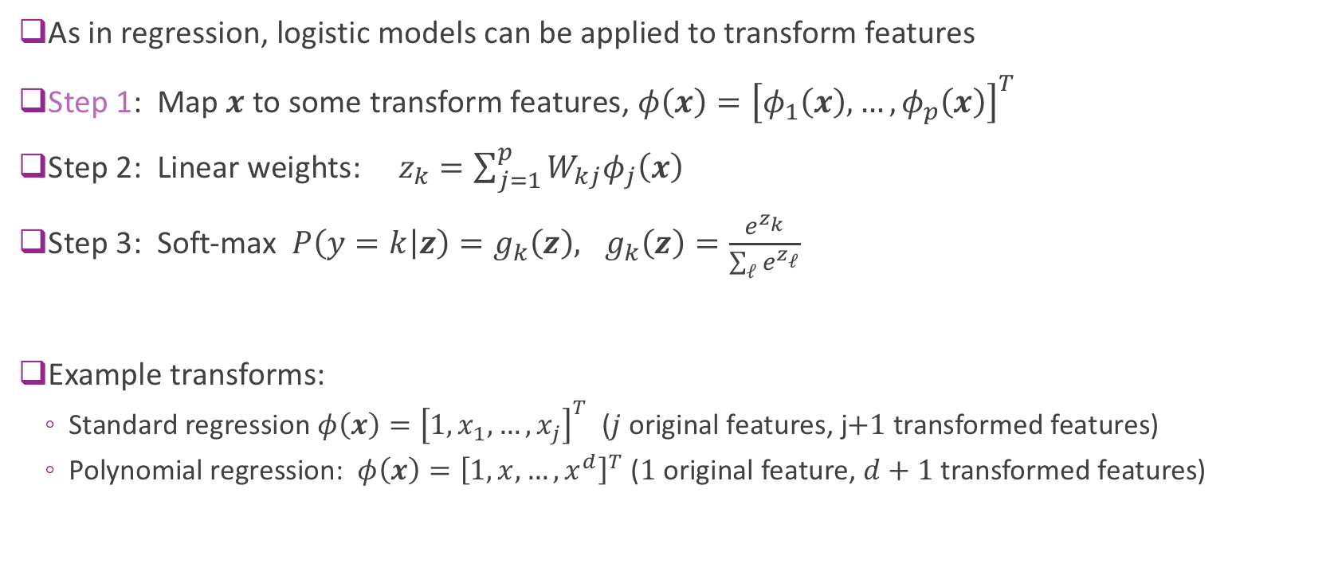
Transform Linear Models
As in regression, logistic models can be applied to transform features
Step 1: Map $x$ to some transform features, $φ\left(x\right)={\left[φ_{1}\left(x\right),…,φ_{p}\left(x\right)\right]}^{T}$
Step 2: Linear weights: $z_{k}=\sum_{j=1}^{p}{{W_{kj}φ}_{j}\left(x\right)}$
Step 3: Soft-max $P\left(y=k | z\right)=g_{k}\left(z\right), g_{k}\left(z\right)=\frac{e^{z_{k}}}{\sum_{ℓ}{e^{z_{ℓ}}}}$
Example transforms:
Standard regression $φ\left(x\right)={\left[1,x_{1},…, x_{j}\right]}^{T}$ ($j$ original features, j$+1$ transformed features)
Polynomial regression: $φ\left(x\right)={\left[1,x,…, x^{d}\right]}^{T}$ ($1$ original feature, $d+1$ transformed features)
Additional transform step

Slide 34
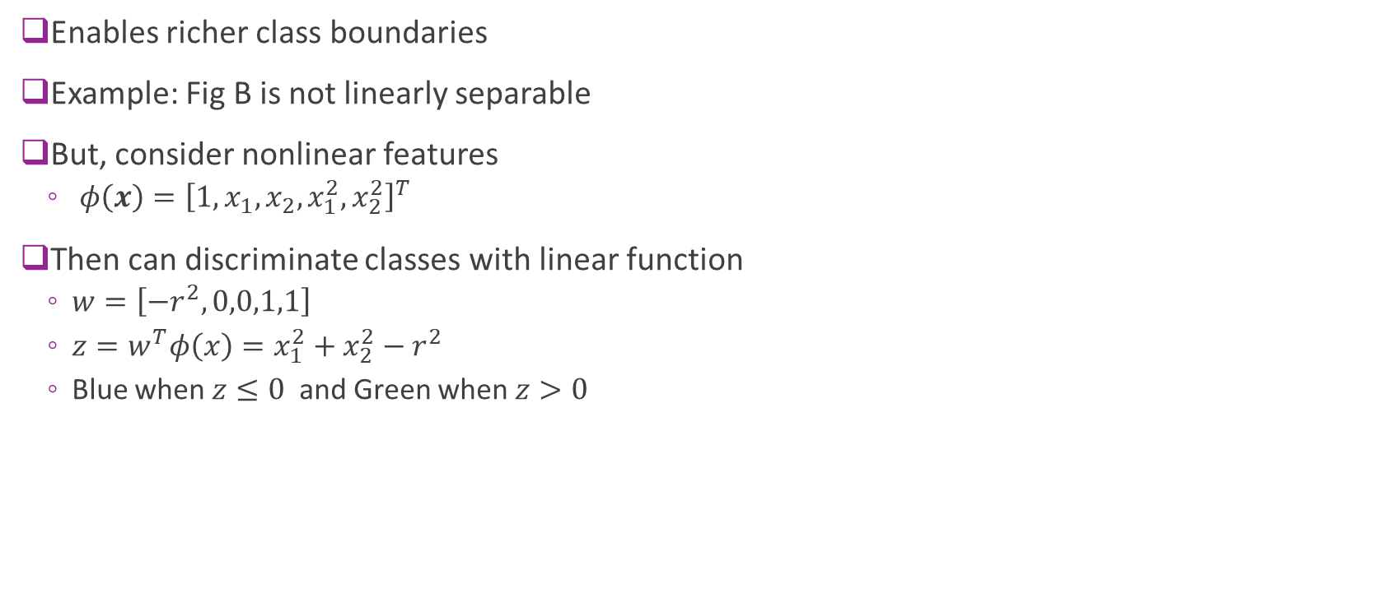
Using Transformed Features
Enables richer class boundaries
Example: Fig B is not linearly separable
But, consider nonlinear features
$φ\left(x\right)={\left[1,x_{1},x_{2},x_{1}^{2},x_{2}^{2}\right]}^{T}$
Then can discriminate classes with linear function
$w=\left[{−r}^{2},0,0,1,1\right]$
$z=w^{T}φ\left(x\right)=x_{1}^{2}+x_{2}^{2}−r^{2}$
Blue when $z≤0$ and Green when $z>0$

Slide 35
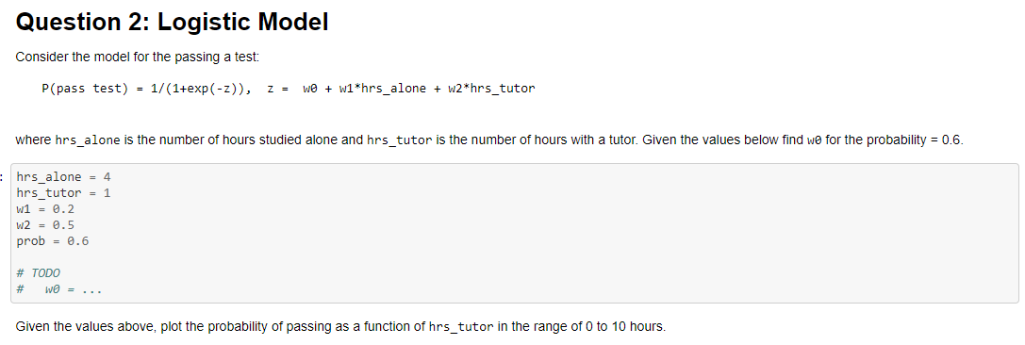
In-Class Exercise
Complete in logistic_inclass.ipynb
Can use Google colab or your local machine

Slide 36
Outline
Motivating Example: Classifying a breast cancer test
Linear classifiers
Logistic regression
Fitting logistic regression models
Measuring accuracy in classification

Slide 37
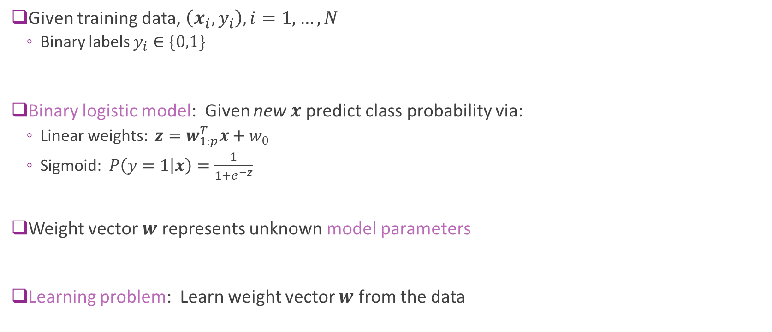
How To Fit Logistic Models?
Given training data, $\left(x_{i},y_{i}\right), i=1,…,N$
Binary labels $y_{i}∈\{0,1\}$
Binary logistic model: Given new $x$ predict class probability via:
Linear weights: $z=w_{1:p}^{T}x+w_{0}$
Sigmoid: $P\left(y=1 | x\right)=\frac{1}{1+e^{−z}}$
Weight vector $w$ represents unknown model parameters
Learning problem: Learn weight vector $w$ from the data
?

Slide 38
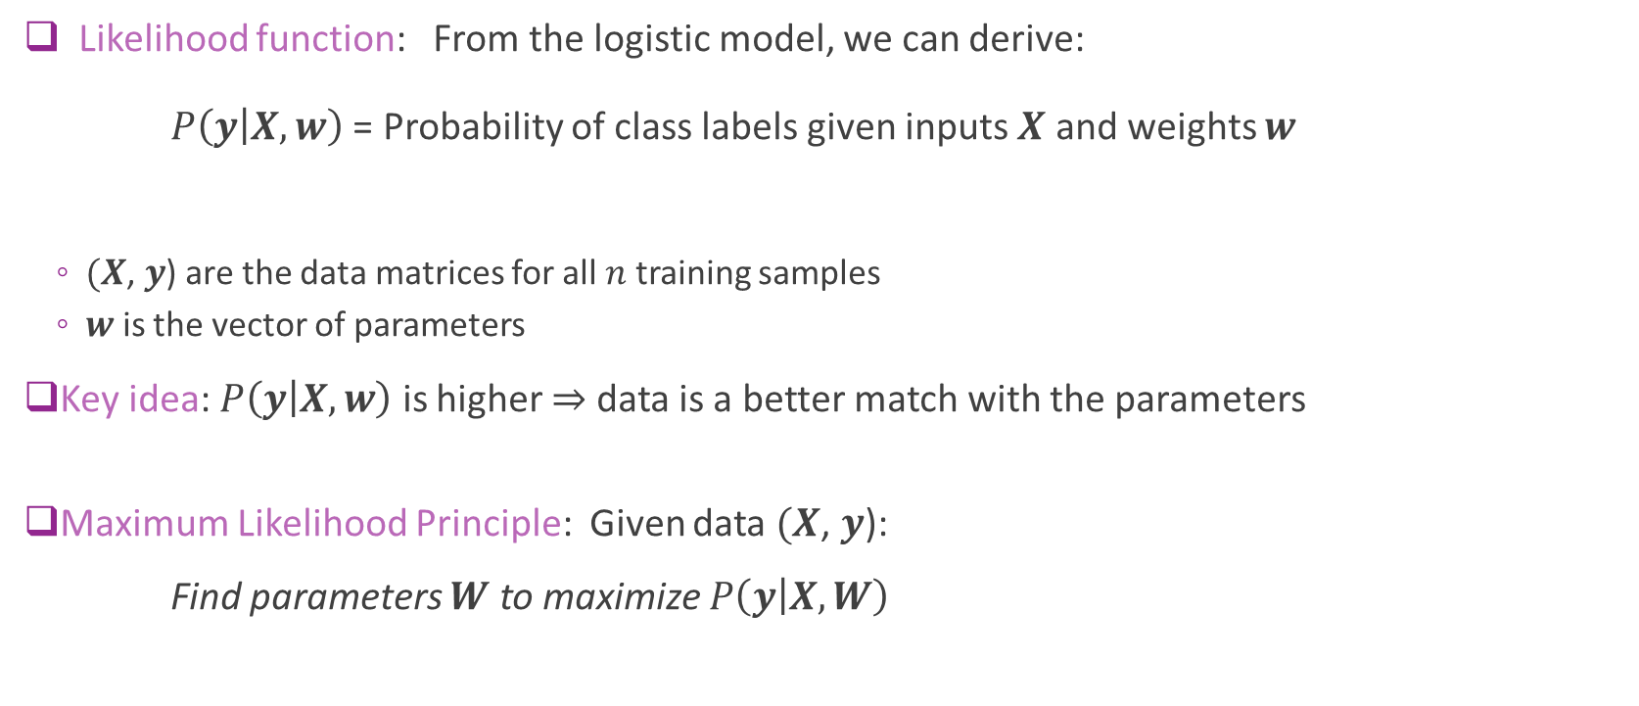
Maximum Likelihood Principle
Likelihood function: From the logistic model, we can derive: $P\left(y | X,w\right)$ = Probability of class labels given inputs $X$ and weights $w$
$(X$, $y$) are the data matrices for all $n$ training samples
$w$ is the vector of parameters
Key idea: $P\left(y | X,w\right)$ is higher $⇒$ data is a better match with the parameters
Maximum Likelihood Principle: Given data $(X$, $y$):
Find parameters $W$ to maximize $P\left(y | X,W\right)$

Slide 39

Binary Cross Entropy
Given data $\left(x_{i},y_{i}\right), i=1,…,N$ with binary labels $y_{i}∈\{0,1\}$
Theorem: MLE for logistic model is equivalent to minimizing the binary cross entropy: $J\left(w\right)=\sum_{i=1}^{n}{\ln\left[1+e^{z_{i}}\right]−y_{i}z_{i}}, z_{i}=w_{0}+\sum_{j=1}^{d}{w_{j}x_{ij}}$
Find the weight vector $w$ to minimize $J\left(w\right)$
Will prove below this is equivalent to maximizing $P(y|X,w)$
Provides a simple cost function to minimize for fitting
Note that $z_{i}$ are implicitly function of weights $w$

Slide 40




Visualizing BCE
Binary cross entropy $J\left(w\right)=\sum_{i=1}^{n}{\ln\left[1+e^{z_{i}}\right]−y_{i}z_{i}}, z_{i}=w_{0}+\sum_{j=1}^{d}{w_{j}x_{ij}}$
Each term has cost $\ln\left[1+e^{z_{i}}\right]−y_{i}z_{i}$
$y_{i}=0⇒$Tries to make $z_{i}$ negative
$y_{i}=1⇒$Tries to make $z_{i}$ positive
Higher cost for $y=1$
Higher cost for $y=0$

Slide 41




Min and Argmin
Given a function $f(x)$
$\min_{x}{f\left(x\right)}$
Minimum value of the $f(x)$
Point on the $y$-axis
$\underset{x}{arg min}{f\left(x\right)}$
Value of $x$where $f(x)$ is a minimum
Point on the $x$-axis
Similarly, define $\max_{x}{f\left(x\right)}$ and $\underset{x}{arg max}{f\left(x\right)}$
$$f\left(x\right)={\left(x−1\right)}^{2}+2$$
$$\min_{x}{f\left(x\right)}=2$$
0
1
$$\arg{\min_{x}{f\left(x\right)}}=1$$

Slide 42

MLE Using Argmax
We can write the MLE using argmax
Suppose we have
Data $(X$, $y$)
Likelihood function $P\left(y | X,w\right)$
Then, MLE is equivalent to: $\hat{w}=\arg{\max_{w}{P\left(y | X,w\right)}}$
Equivalent to saying find $w$ to maximize $P\left(y | X,w\right)$

Slide 43


Log Likelihood
Assume outputs $y_{i}$ are independent, depending only on $x_{i}$
Then, likelihood factors: $P\left(y | X,w\right)=\prod_{i=1}^{N}{P(y_{i}|x_{i},w)}$
Define negative log likelihood: $L\left(w\right)=−\ln{P\left(y | X,w\right)}=−\sum_{i=1}^{N}{\ln{P\left(y_{i} | x_{i},w\right)}}$
Maximum likelihood estimator can be re-written as: $\hat{w}=\arg{\max_{w}{P\left(y | X,w\right)}}=\arg{\min_{w}{L\left(w\right)}}$
Negative Log Likelihood

Slide 44

Cross Entropy
The cross-entropy of the distribution q relative to a distribution is defined as follows:
$H\left(p,q\right)=−Σ_{x}p\left(x\right)log⁡(q\left(x\right))$
Similar to entropy of a distribution:
$H\left(p\right)=−Σ_{x}p\left(x\right)log⁡(p\left(x\right))$
It measures the difference in distribution p and q
Cross-entropy is minimum when two distribution are equal
Otherwise, it is $H\left(p\right)$+ Divergence between p and q (Kullback–Leibler)

Slide 45

Logistic Loss = Binary Cross Entropy
Negative log likelihood function: $J\left(w\right)=−\sum_{i=1}^{n}{\ln{P\left(y_{i} | x_{i},w\right)}}$
$$P\left(y_{i}=1 | x_{i},w\right)=\frac{1}{1+e^{−z_{i}}}, z_{i}=w_{1:p}^{T}x_{i}+w_{0}$$
Therefore, $P\left(y_{i}=1 | x_{i},w\right)=\frac{e^{z_{i}}}{1+e^{z_{i}}}, P\left(y_{i}=0 | x_{i},w\right)=\frac{1}{1+e^{z_{i}}}$
Hence, $\ln{P(y_{i}|x_{i},w)}=y_{i}\ln{P(y_{i}=1|x_{i},w)}+\left(1−y_{i}\right)\ln{P\left(y_{i}=0 | x_{i},w\right)}=y_{i}z_{i}−\ln\left[1+e^{z_{i}}\right]$
Loss function = binary cross entropy: $J\left(w\right)=\sum_{i=1}^{n}{\ln\left[1+e^{z_{i}}\right]−y_{i}z_{i}}$

Slide 46

Multi-Class Classification
For multi-class classification, define the “one-hot” vector: $r_{ik}=\left\{\begin{matrix}1 & y_{i}=k \\ 0 & y_{i}≠k\end{matrix}\right., i=1,…,N, k=1,…, K$
Then, $\ln{P\left(y_{i} | x_{i},W\right)}=\sum_{k=1}^{K}{r_{ik}\ln{P\left(y_{i}=k | x_{i},W\right)}}$
Hence, negative log likelihood is: $J\left(W\right)=\sum_{i=1}^{N}{\left[\ln\left[\sum_{k}{e^{z_{ik}}}\right]−\sum_{k}{z_{ik}r_{ik}}\right]}$
Sometimes called the categorial cross-entropy
Can prove this with some algebra

Slide 47

Gradient Calculations
To minimize take partial derivatives: $\frac{∂J\left(W\right)}{∂W_{kj}}=0$ for all $W_{kj}$
Define transform matrix: $A_{ij}=φ_{j}(x_{i})$
Hence, $z_{ik}=\sum_{j=1}^{p}{A_{ij}W_{kj}}$
Estimated class probabilities: $p_{ik}=\frac{e^{z_{ik}}}{\sum_{ℓ}{e^{z_{iℓ}}}}$
Gradient components are: $\frac{∂L\left(W\right)}{∂W_{kj}}=\sum_{i=1}^{N}{\left(p_{ik}−r_{ik}\right)A_{ij}}=0$
$K×p$ equations and $K×p$ unknowns
Unfortunately, no closed-form solution to these equations
Nonlinear dependence of $p_{ik}$ on terms in $W$

Slide 48

Numerical Optimization
We saw that we can find minima by setting $∇f\left(x\right)=0$
$M$ equations and $M$ unknowns.
May not have closed-form solution
Numerical methods: Finds a sequence of estimates $x^{t}$ $x^{t}→x^{∗}$
Under some conditions, it converges to some other “good” minima
Run on a computer program, like python
Next unit: Will discuss numerical methods to perform optimization
This lecture: Use built-in python routine

Slide 49


In-Class Exercise
Complete in logistic_inclass.ipynb
Can use Google colab or your local machine

Slide 50
Outline
Motivating Example: Classifying a breast cancer test
Linear classifiers
Logistic regression
Fitting logistic regression models
Returning to the breast cancer dataset
Measuring accuracy in classification

Slide 51





Fitting Two Variables
Get the two variables
Scale, fit and test
Regularization note for sklearn
Always performs regularized regression:
Minimizes $J\left(w\right)+\frac{1}{2C}{\left\|w\right\|}^{2}$
$J\left(w\right)=$ Negative log likelihood
$\frac{1}{2C}{\left\|w\right\|}^{2}=$ regularization term (like Ridge)
Used for numerical stability

Slide 52


Visualizing the Decision Regions
Probability output:
Smooth value from 0 to 1
Class decision:
$\hat{y}=1$ when $P\left(y=1 | x\right)>0.5$
$\hat{y}=0$ when $P\left(y=1 | x\right)≤0.5$
Decision boundary is a line
Similar to what we manually selected

Slide 53



Fitting All The Variables
With all 10 variables:
Get 97% test accuracy
10-fold cross validation
Also in demo
Accuracy = 0.967
SE = 0.011

Slide 54

In-Class Exercise
Complete in logistic_inclass.ipynb
Can use Google colab or your local machine

Slide 55
Outline
Motivating Example: Classifying a breast cancer test
Linear classifiers
Logistic regression
Fitting logistic regression models
Measuring accuracy in classification

Slide 56


Errors in Binary Classification
Two types of errors:
Type I error (False positive / false alarm): Decide $\hat{y}=1$ when $y=0$
Type II error (False negative / missed detection): Decide $\hat{y}=0$ when $y=1$
Implication of these errors may be different
Think of breast cancer diagnosis
Accuracy of classifier can be measured by:
$TPR=P(\hat{y}=1|y=1)$
$FPR=P\left(\hat{y}=1 | y=0\right)$
Accuracy=$P(\hat{y}=1|y=1)$+ $P\left(\hat{y}=0 | y=0\right)$
(percentage of correct classification)

Slide 57

Many Other Metrics
From previous slide
$TPR=P(\hat{y}=1|y=1)$=sensitivity
$FPR=P\left(\hat{y}=1 | y=0\right)$=1-specificity
Machine learning often uses (positive=items of interests in retrieval applications)
Recall = Sensitivity =TP/(TP+FN) (How many positives are detected among all positive?)
Precision =TP/(TP+FP) (How many detected positive is actually positive?)
F1-score = $\frac{Precision ∗Recall}{(Precision+Recall)/2}=\frac{2TP}{2TP+FN+FP}$ $=\frac{TP}{TP+\frac{FN+FP}{2}}$
Accuracy=(TP+TF)/(TP+FP+TN+FN) (percentage of correct classification)
Medical tests:
Sensitivity = $P\left(\hat{y}=1 | y=1\right)=TPR$
Specificity = $P\left(\hat{y}=0 | y=0\right)=1−FPR$ =True negative rate
Need a good tradeoff between sensitivity and specificity

Slide 58


Breast Cancer
Measure accuracy on test data
Use 4-fold cross-validation
Sklearn has built-in functions for CV

Slide 59
Go through the demo
Up to binary classification with cross validation

Slide 60

Hard Decisions
Logistic classifier outputs a soft label: $P\left(y=1 | x\right)∈[0,1]$
$P\left(y=1 | x\right)≈1⇒y=1$ more likely
$P\left(y=0 | x\right)≈1⇒y=0$ more likely
Can obtain a hard label by thresholding:
Set $\hat{y}=1 if P\left(y=1 | x\right)>t$
$t$ = Threshold
How to set threshold?
Set $t=\frac{1}{2}⇒$ Minimizes overall error rate
Increasing $t⇒$ Decreases false positives, but also reduces sensitivity
Decreasing $t⇒$ Increases sensitivity, but also increases false positive

Slide 61

ROC Curve
Varying threshold obtains a set of classifier
Trades off FPR (1-specificity) and TPR (sensitivity)
Can visualize with ROC curve
Receiver operating curve
Term from digital communications

Slide 62

Area Under the Curve (AUC)
As one may choose a particular threshold based on the desired trade-off between the TPR and FPR, it may not be appropriate to evaluate the performance of a classifier for a fixed threshold.
AUC is a measure of goodness for a classifier that is independent of the threshold.
A method with a higher AUC means that under the same FPR, it has higher PPR.
What is the highest AUC?
Should report average AUC over cross validation folds

Slide 63

Multi-Class Classification in Python
Two options
One vs Rest (OVR)
Solve a binary classification problem for each class $k$
For each class $k$, train on modified binary labels (indicates if sample is in class or not) ${\tilde{y}}_{i}=\left\{\begin{matrix}1 & \text{if} y_{i}=k \\ 0 & \text{if} y_{i}≠k\end{matrix}\right.$
Predict based on classifier that yields highest score
Multinomial
Directly solve weights for all classes using the multi-class cross entropy

Slide 64


Metrics for Multiclass Classification
Using a $K×K$ confusion matrix
Should normalize the matrix:
Sum over each row =1
Can compute accuracy:
Per class: This is the diagonal entry
Average: The average of the diagonal entries
Pred--> Real$↓$ | 1 | 2 | … | K
1
2
…
K

Slide 65


LASSO Regularization for Logistic Regression
Similar to linear regression, we can use LASSO regularization with logistic regression
Forces the weighting coefficients to be sparse.
Add L1 penalty $L\left(W\right)=\sum_{i=1}^{N}{\left[\ln\left[\sum_{k}{e^{z_{ik}}}\right]−z_{ik}r_{ik}\right]+λ {\left\|W\right\|}_{1}}$
The regularization level $λ$ should be chosen via cross validation as before
Sklearn implementation:
Default use l2 penalty, to reduce the magnitude of weights
C is the inverse of regularization strength $(C=1/λ$); must be a positive float.
Should use a large C is you do not want to apply regularization
Go through the LASSO part of the demo

Slide 66
Go through the demo
Go though the last part with LASSO regression

Slide 67
What You Should Know
Formulate a machine learning problem as a classification problem
Identify features, class variable, training data
Visualize classification data using a scatter plot.
Describe a linear classifier as an equation and on a plot.
Determine visually if data is perfect linearly separable.
Formulate a classification problem using logistic regression
Binary and multi-class
Describe the logistic and soft-max function
Understand the idea of using the logistic function to approximate the probability
Derive the loss function for ML estimation of the weights in logistic regression
Use sklearn packages to fit logistic regression models
Measure the accuracy of classification: precision, recall, accuracy
Adjust threshold of classifiers for trading off types of classification errors. Draw a ROC curve and determine AUC
Perform LASSO regularization for feature selection

